Slide 1
NiFi DevOps
Continuous Integration / Continuous Delivery (CI/CD)

Slide 2




Objectives of CI/CD
Increased productivity
Solving problem in the right way
Simplify and consolidate
Code quality
Easier and faster deployments
Standardized process
Fewer bugs & hotfixes
Well-tested code
Getting everyone to care about quality
Fewer manual steps
Same deployment process in lower environments and Prod
Master code repository
Reuse existing code to solve similar problems
Share solution with other developers
Coding standards

Slide 3
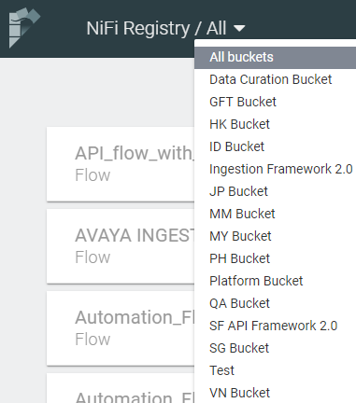
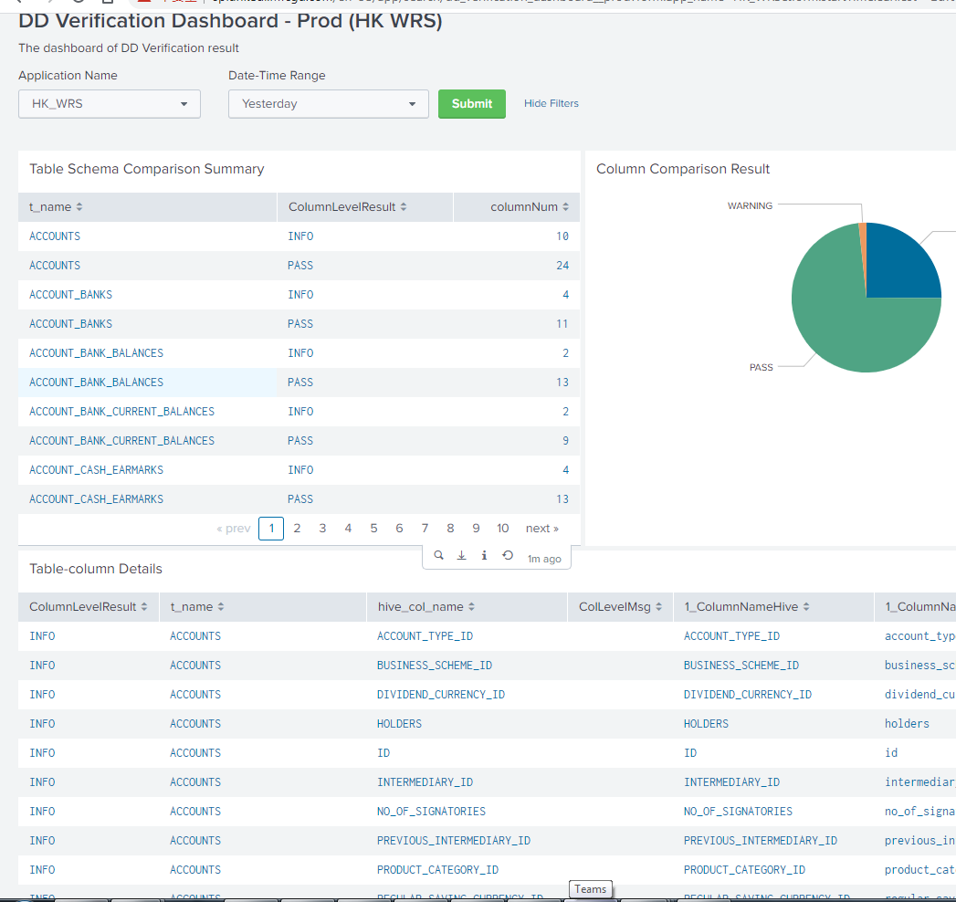
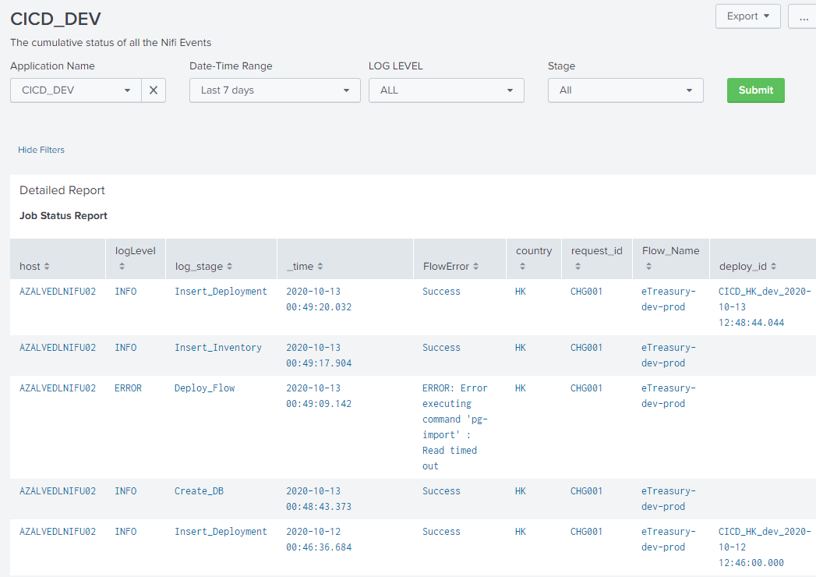
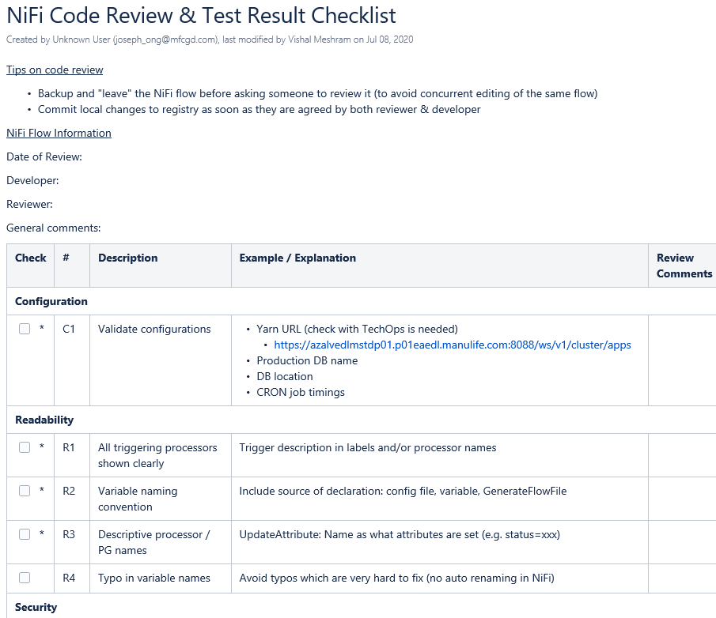
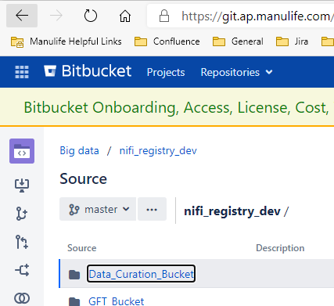
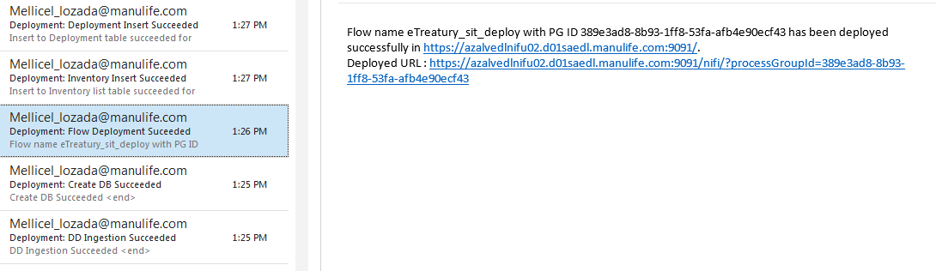
High-Level Steps
Development
Testing
Row count
Data comparison
Code Review
Checklist
Code scanning
Deployment
·Repeatable deployment process
·Automate
manual steps
Metadata comparison
Source code repository
Deployment & version control
Metadata comparison / Data reconciliation
Deployment dashboard
Source version control
Code review checklist / Code scanning
Deployment alerts

Slide 4
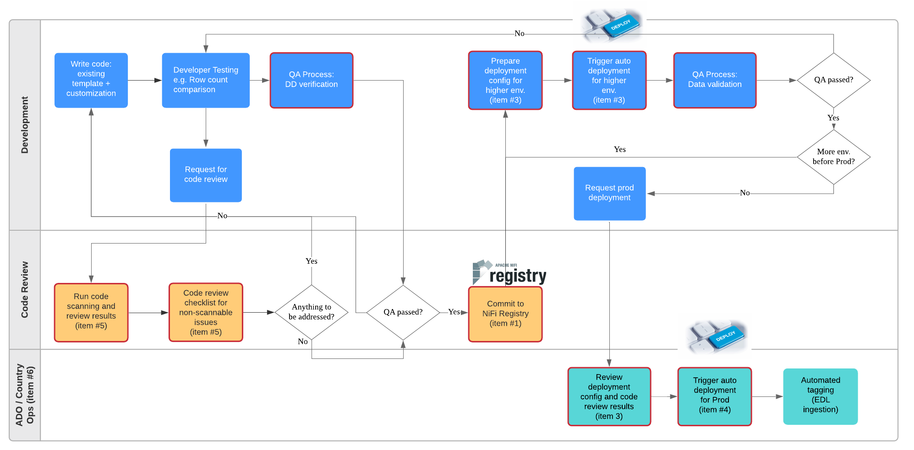
NiFi Coding, Testing, and Deployment Flow
Repeat for lower environments
Config
Deploy
Test
Code review
Version control

Slide 5
Trial run of CI/CD with eTreasury

Slide 6
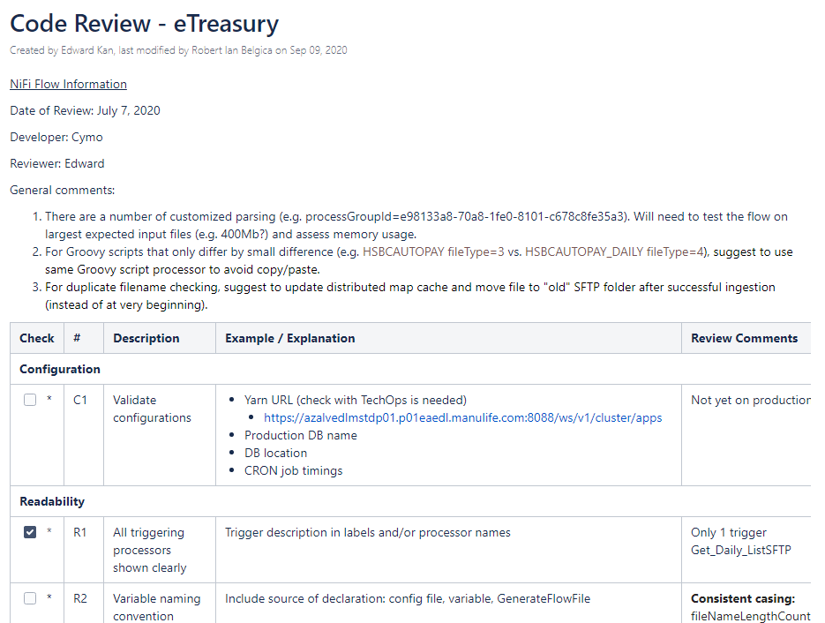
eTreasury - Code Review
https://confluence.ap.manulife.com/display/ADO/Code+Review+-+eTreasury

Slide 7
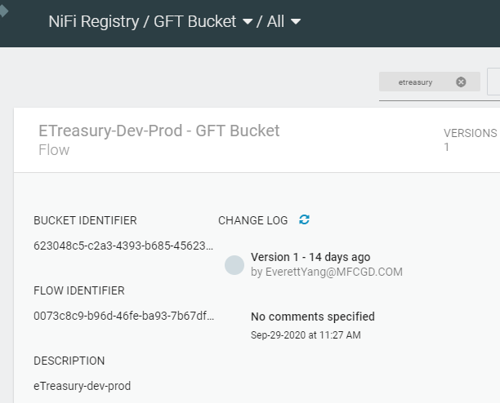
eTreasury – Version Control

Slide 8
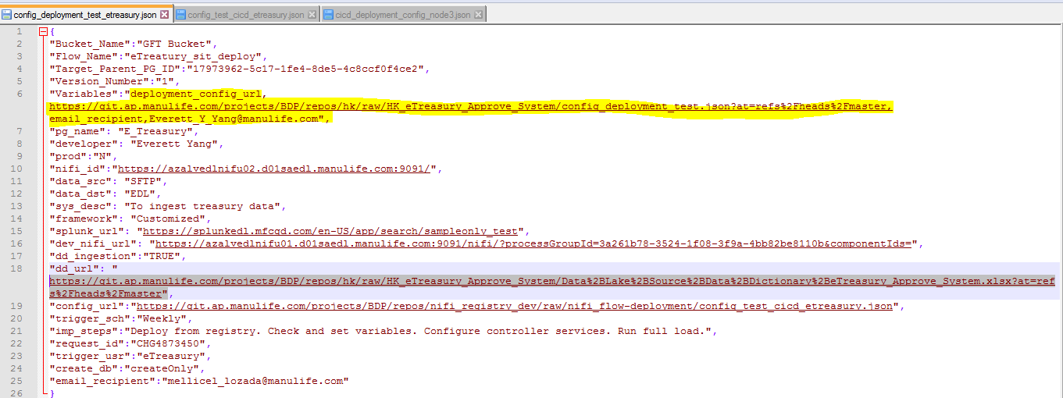
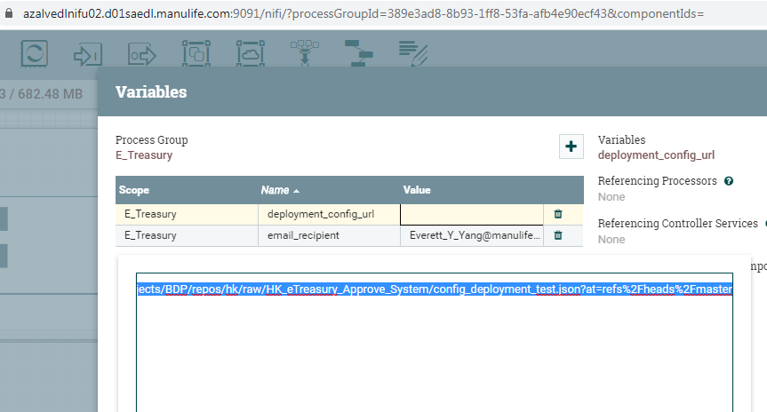
eTreasury – Config

Slide 9
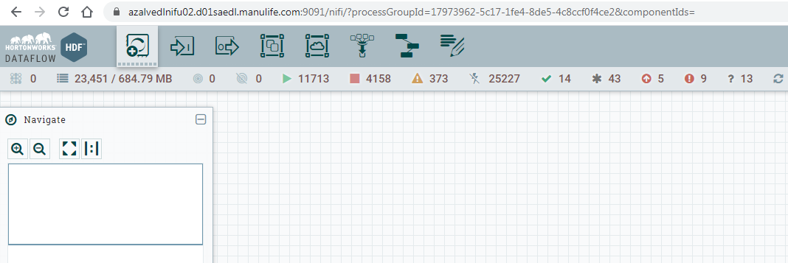
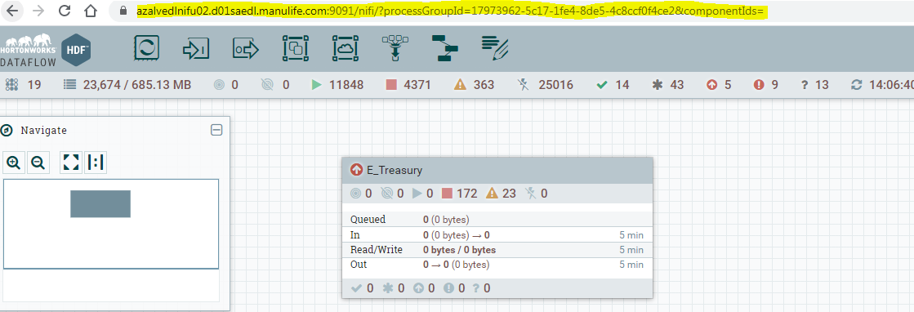
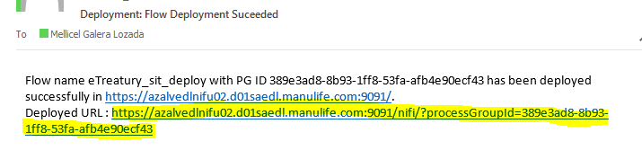
eTreasury - Deploy
BEFORE: AFTER:
NOTIFY: DASHBOARD:

Slide 10
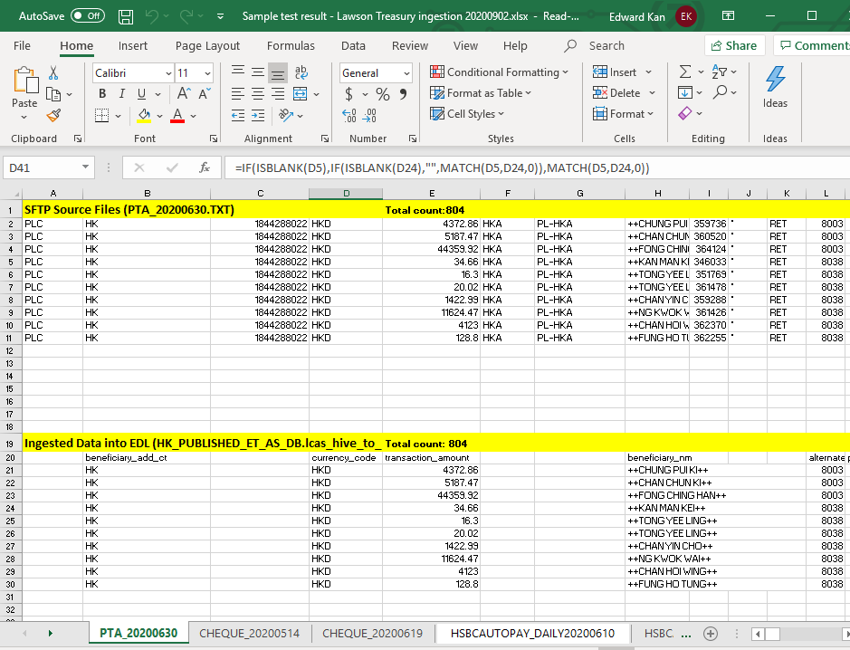
eTreasury – Test

Slide 11
Appendix

Slide 12
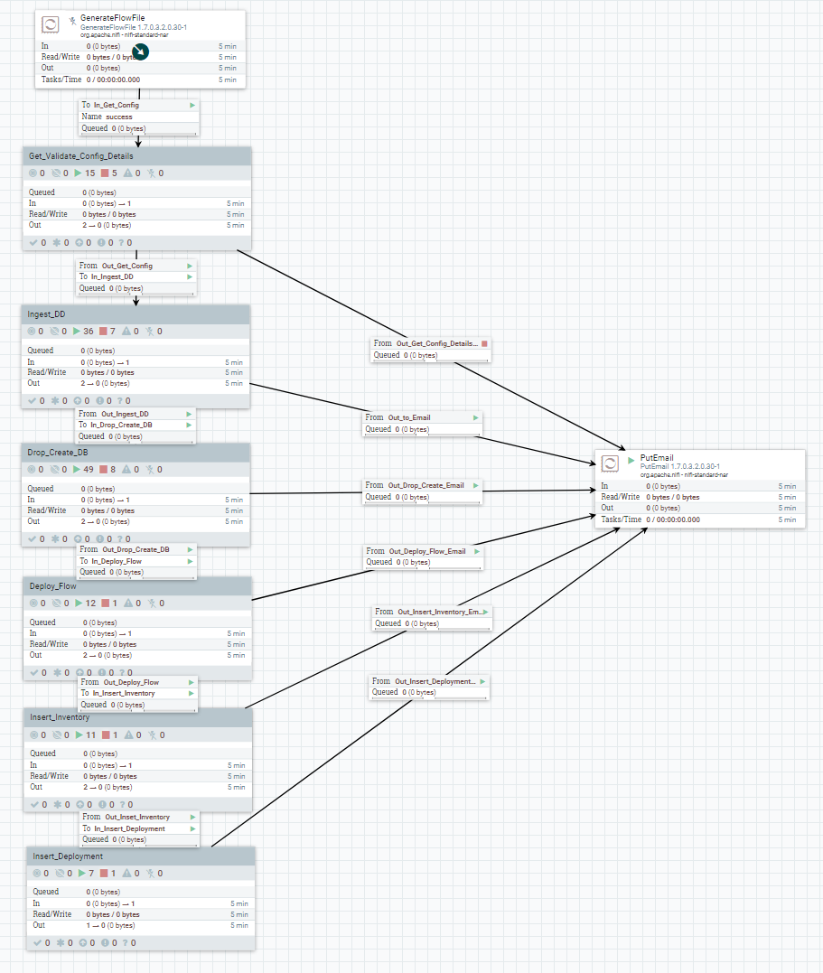
Automated Deployment
Existing Word file-based deployment template ADO Deployment Template
MVP1: Automating 9 out of 14 steps
4.1. NiFi Registry – Source version details
4.2. NiFi flow location on VC2
4.3. DD location / ingestion
4.6. Production ready config files (ingestion/curation)
4.9. List of variables in NiFi flow to be set
4.11. Create / delete databases if needed
4.12. Scheduling details
4.13. Splunk setup details
4.14. Implementation steps
Remaining steps for later MVPs
4.4. Strategy file location & deployment
4.5. Multi mapper file location & deployment
4.7. Source connection details
4.8. Controller settings
4.10. Script locations / password files

Slide 13
Duties by Operations / Support Group
Activities | ADO / Country Engineers | Engineering SME | ADO QA | ADO / Country Ops | Business Analysts ² | MBPS L1 Support Team
Development
NiFi development | ✓
Developer testing | ✓
Code review ¹ | ✓
Code review checklist / automation |  | ✓
QA / Testing
QA / Record count comparison | ✓ |  |  |  | ✓
Testing automation / criteria |  |  | ✓
E2E testing |  |  |  |  | ✓
Deployment
Deployment automation |  | ✓
Preprod (SIT/UAT) deployment | ✓
Production deployment | ✓ |  |  | ✓ | ✓ (CR)
Post-Deployment
Production monitoring |  |  |  | ✓ |  | ✓
Incident management | ✓ |  |  | ✓
Code review must be done by a peer engineer other than the developer.
Task Matrix: https://confluence.ap.manulife.com/display/ADO/Tasks+Matrix

Slide 14
References
NiFi code review checklist
Automated deployment for NiFi flows

